Slide 1
Subnetting
This is a power point presentation made by Riya Chowdhury

Slide 2
ASSIGNMENT
NAME- Riya Chowdhury
ROLL- 16800117034
STREAM- C.S.E
SEM- 6th
SUB- Computer Networking

Slide 3
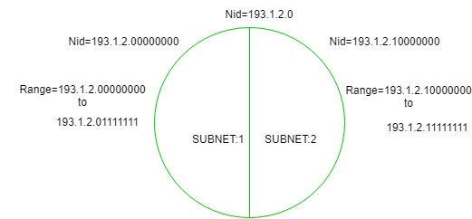
Introduction To Subnetting :-
When a bigger network is divided into smaller networks, in order to maintain security, then that is known as Subnetting. so, maintenance is easier for smaller networks.
Now, let’s talk about dividing a network into two parts:
so to divide a network into two parts, you need to choose one bit for each Subnet from the host ID part.

Slide 4
In the above diagram, there are two Subnets.
For Subnet-1:
The first bit which is chosen from the host id part is zero and the range will be from (193.1.2.00000000 till you get all 1’s in the host ID part i.e, 193.1.2.01111111) except for the first bit which is chosen zero for subnet id part.
Thus, the range of subnet-1: 193.1.2.0 to 193.1.2.127
For Subnet-2:
The first bit chosen from the host id part is one and the range will be from (193.1.2.100000000 till you get all 1’s in the host ID part i.e, 193.1.2.11111111).
Thus, the range of subnet-2: 193.1.2.128 to 193.1.2.255

Slide 5
Subnetting Explained with Examples:-
The process of subnetting involves dividing a network up into smaller networks called subnets or sub networks. Each of these subnets has its own specific address. To create these additional networks we use a subnet mask. The subnet mask simply determines which portion of the IP address belongs to the host. The subnet address is created by dividing the host address into network address and host address.
The network address specifies the type of subnetwork in the network and the host address specifies the host of that subnet. Subnets are under local administration. As such, the outside world sees an organization as a single network and has no detailed knowledge of the organization's intema1 structure. Subnetting provides the network administrator with several benefits, including extra flexibility, more efficient use of network address and the capability to contain broadcast traffic. A given .network address can be broken up into may subnetworks.
A subnet address is created by. borrowing bits from the host field and designating them as subnet field. The number of bits borrowed varies and is specified by the subnet mask.

Slide 6
Subnetting Direction:-
Subnetting always flows in single direction (left to right) without skipping any bit. This simple rule gives us the exact location of Subnetting bits in an address space. Let’s take an example.
A class C network is subnetted in 4 subnets. Find the number of host bits used in Subnetting and their location in address space.
To create 4 subnets we need to 2 (22 = 4) Subnetting eligible host bits.
Since in class C network space Subnetting eligible bits starts from 25 and Subnetting always goes from left to right without skipping any bit, the bits used in this network are 25 and 26.

Slide 7
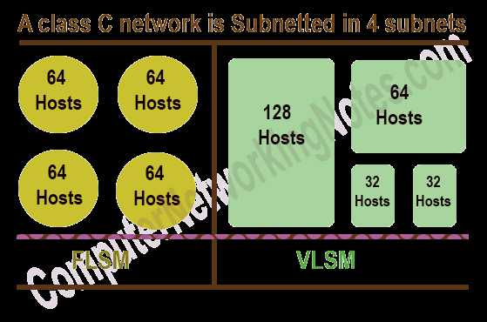
Type of Subnetting:-
There are two types of Subnetting FLSM and VLSM. In FLSM, all subnets have equal number of host addresses and use same Subnet mask. In VLSM, subnets have flexible number of host addresses and use different subnet mask.
Following figure shows an example of FLSM and VLSM.
FLSM is easy in implementation and simple in operation but wastes a lot of IP addresses. VLSM is hard in implementation and complex in operation but utilizes maximum IP addresses.
Several steps involve in both types of Subnetting. Due to length of this tutorial, I will explain both types of Subnetting individually in next parts of this article.

Slide 8
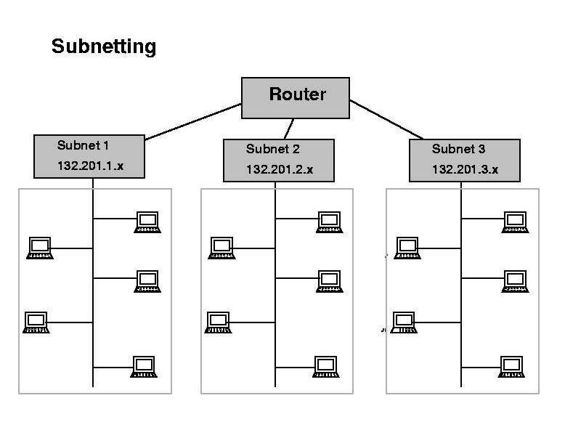
Subnetting

Slide 9
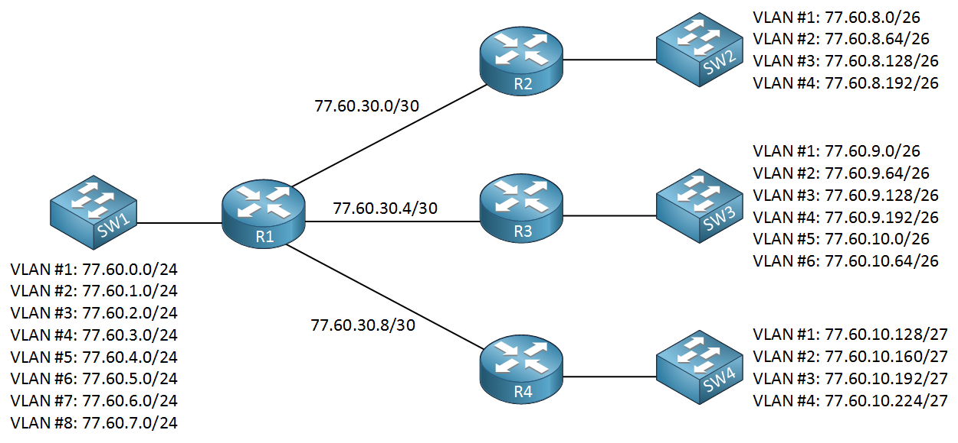
Subnetting

